Slide 1
Life Edit Mid-Semester Deliverable

Slide 2

Project Overview
Life Edit is a gene editing company that aims to develop gene therapies for complex genetic disorders.
They hope to treat individuals with genetic disorders which were previously untreatable
Project goal: develop a classifier that differentiates edited cells and unedited cells using RNA gene expression data
Determining differences between edited and unedited cells is essential for Life Edit to understand the impact of its editing tools

Slide 3
Summary of Work
EDA was performed to study the distribution of gene expressions
PCA was carried out to determine how samples and genes are clustered
Different methods were used to reduce the number of genes and obtain the set of features for classification
Eliminating genes based on differences in gene expression
Using PCA to create groups of genes and find interpretability
Clustering genes based on biological function

Slide 4
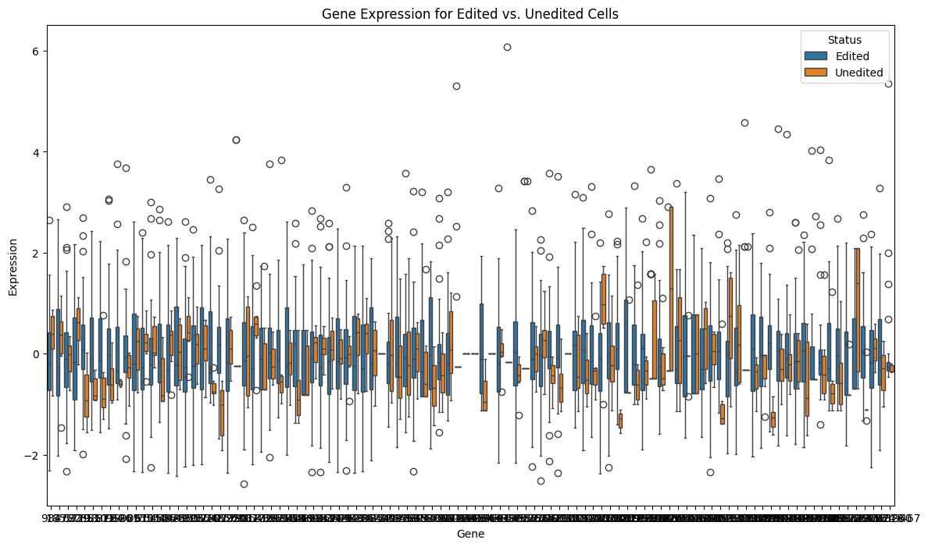
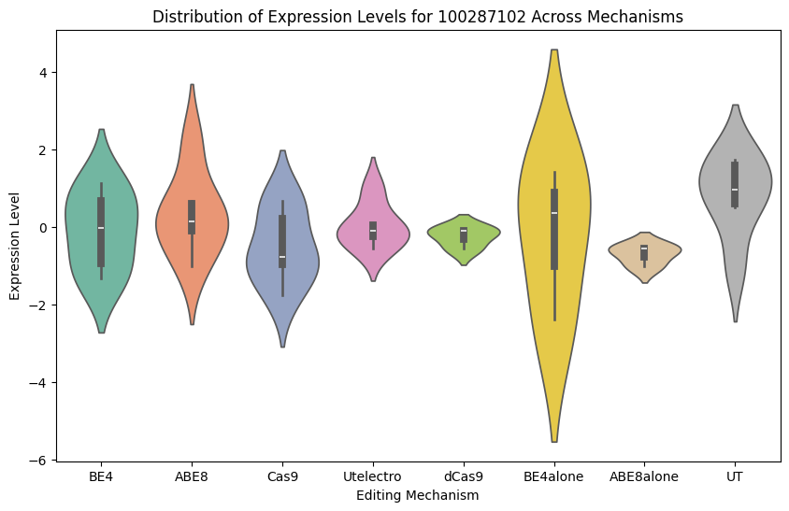
EDA

Slide 5
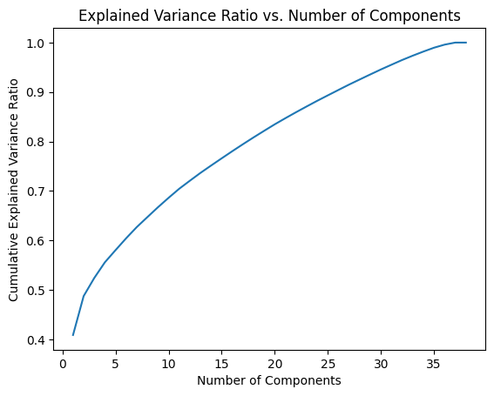
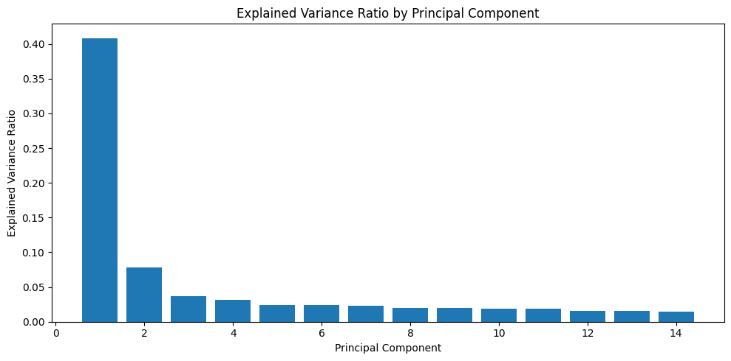
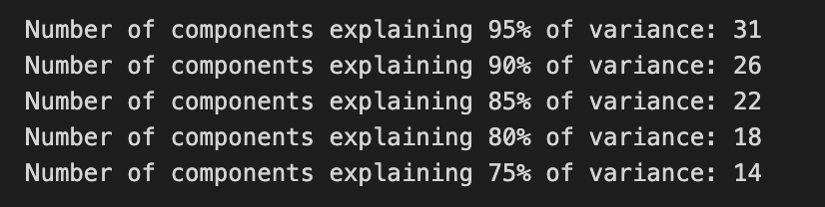
PCA

Slide 6
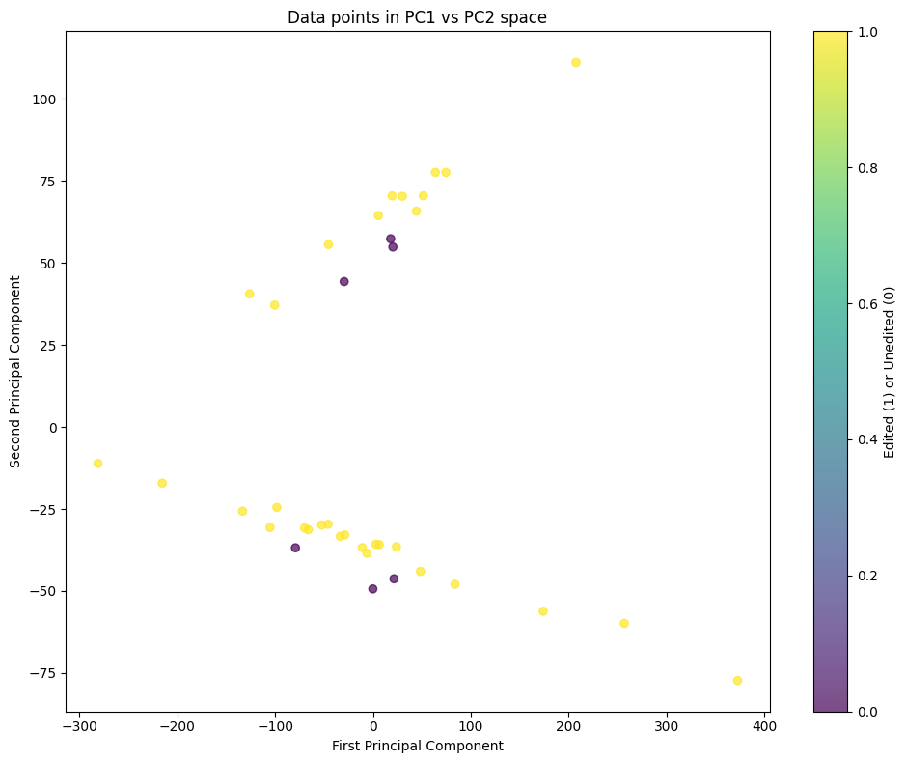
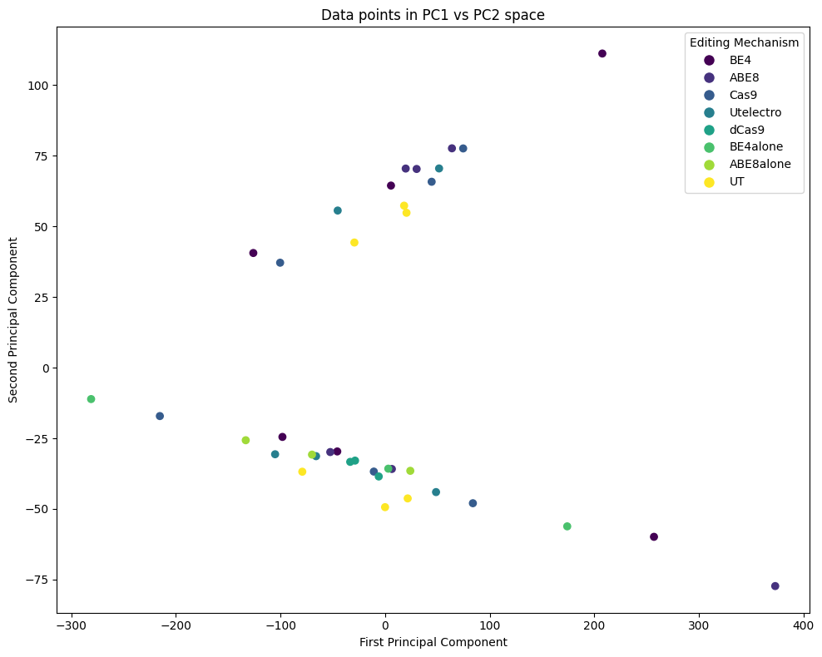
PCA
Samples: edited (yellow) vs. unedited (purple)
Samples: by editing mechanism
Notes:
BE4 and ABE8 (base conversions) seem to be clustered in the upper region.
dCas9, which is used to regulate gene expression by recruiting activator or repressor proteins, seems to be clustered in the lower region of the graph.
BE4alone and ABE8alone (simplified versions of the editors) both lie in the lower region of the graph.

Slide 7
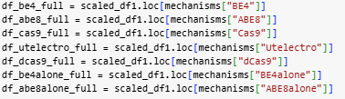
Gene Filtering
Edited
Unedited

Slide 8
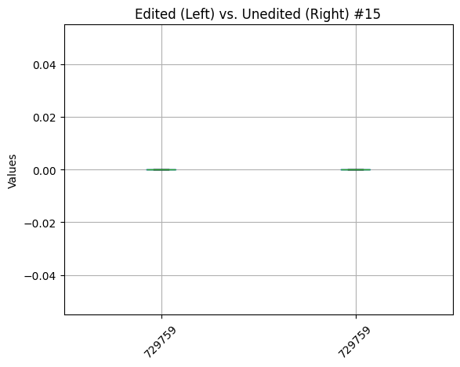
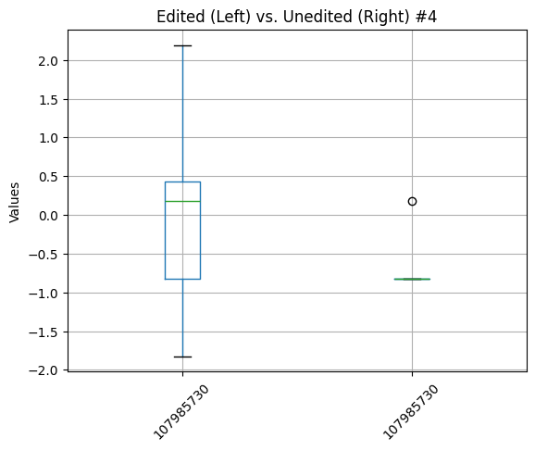
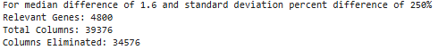
Gene Filtering
Over 39000 genes -> less than 5000

Slide 9
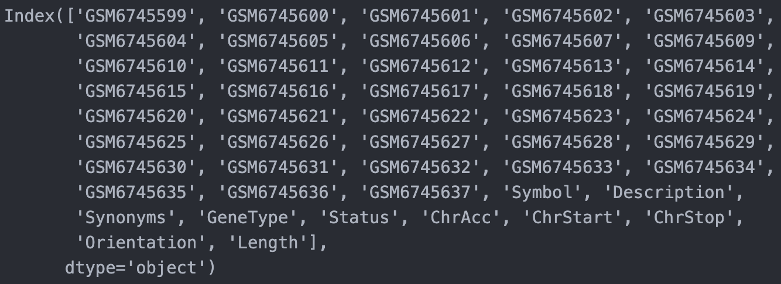
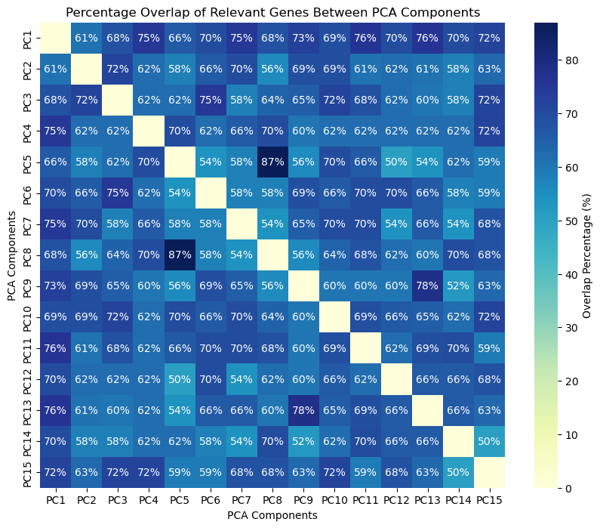
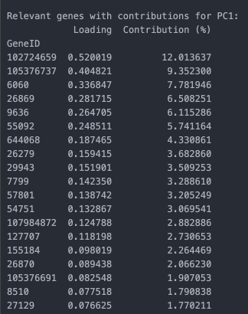
Interpretability Framework
Standardize & Filter Genes
75% of variance was explained by 15 PCA components
PCA w/ DNA expression data
PCA Component Loading*
NLP Processing
(+ More)
Notes:
*Loadings: coefficients showing each original variable's contribution to a principal component

Slide 10
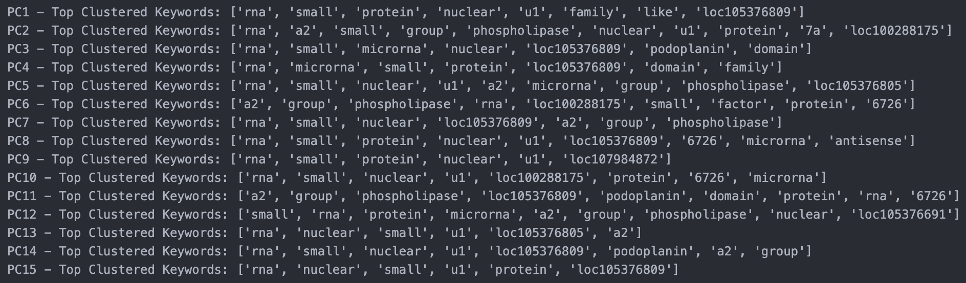
…disappointment
due to high overlap…
*silver lining?
Notes:
There might

Slide 11
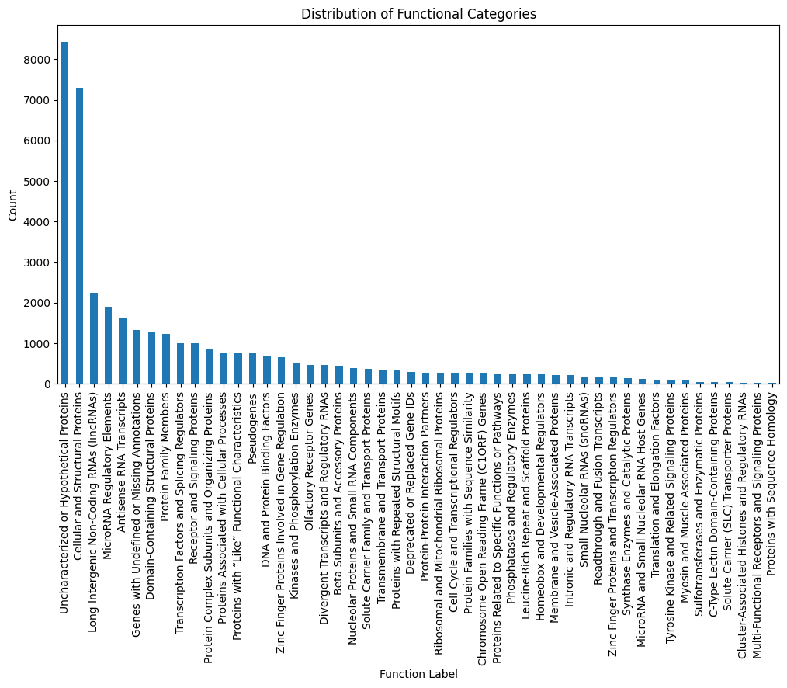
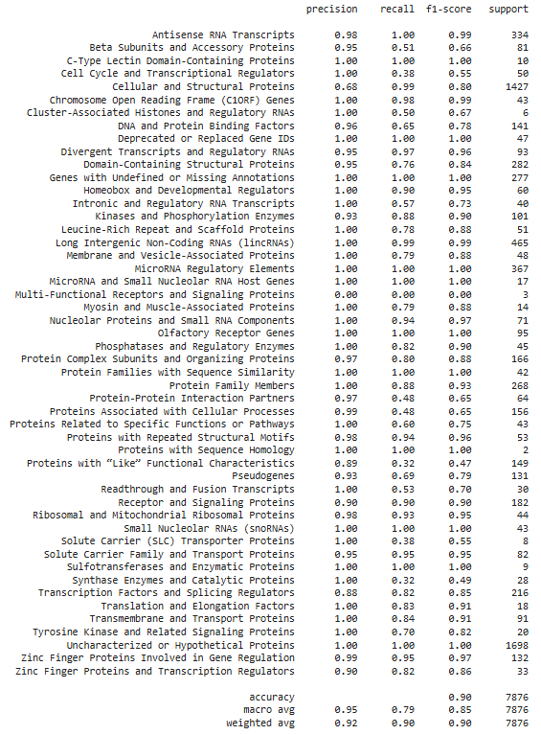
K-Means Clustering
Notes:
High-level summary of the categorization process, libraries, and methodologies used:
Data Preparation and Feature Extraction: We used BERT (Bidirectional Encoder Representations from Transformers) embeddings to convert gene/protein descriptions into feature-rich vector representations. BERT, from the Hugging Face Transformers library, captures semantic nuances, allowing similar terms to have similar embeddings, crucial for clustering related descriptions.
Clustering Algorithm: We applied a clustering algorithm (typically K-Means or a similar model from the scikit-learn library) on these BERT embeddings. This process grouped genes/proteins based on semantic similarity, creating clusters that reflect related functions or biological roles.
Cluster Labeling: Post-clustering, clusters were manually analyzed to identify common functional themes. Each cluster was then assigned a descriptive label based on the shared characteristics of the genes/proteins within it. This labeling provided meaningful insights into the general role of each group.
Result Annotation and Refinement: The final output, stored in a new DataFrame column, allows easy reference to cluster labels. This process used pandas for data manipulation and scikit-learn for clustering, while the BERT embeddings facilitated context-aware categorization of gene/protein functions.

Slide 12
Future Work
Choose a final group of features from the different feature extraction methods
Train different classifiers using these chosen features to determine which model best differentiates edited and unedited cells
Find biological interpretability in the results of the model

